Slide 1
Citizen Chalkboard Budget Workshop Presentation
Student Report
May 3rd 2016

Slide 2
Synopsis
Special Budget workshop called the Citizen Chalkboard was held on April 13th and 14th.
Advertisement occurred on city website, social media, and personal outreach to stakeholder organizations.
Purpose
Transferring budget information and knowledge of the budget process.
Receive Citizen input and preference on various capital projects.
Exchange of knowledge and ideas.

Slide 3
Process
Gathering of relevant capital projects and expenditure estimates.
Analysis of past and present budget data.
Creation of Citizen Chalkboard format and schedule.
Outreach and advertisement.
Conducted April 13th and 14th sessions.

Slide 4
Workshop format
The format of the workshop consisted of four (4) main components.
A presentation and info session on the budget presented by city manager Whitson.
Breakout sessions using “Hapeville dollars” amounting to $2.6 million.
Discussion of T-SPLOST project preferences.
Parking lot component for any questions and comments that did not fit into the workshop format.

Slide 5
Breakout Session
Results were created by taking all six group’s allocation ideas for the $2.6 million.
During the presentation background information relevant to capital projects were presented for funding.
The groups were tasked with prioritizing the spending of $2.6 million.
*Note: Total needs list equaled $18 million

Slide 6
Capital Projects List Summary
Fire Department
Fire Station #2 Lighting and Instillation $10,000
Replacement of Engine Two and Three $800,000-$900,000
Replacement of both ambulance units $400,000-$500,000
Community Services
Bucket Truck $35,000
Back Hoe $30,000
Replacement of 2” and 6” waterlines throughout city system 1,700,000
Slip line Sewer system throughout the city $4,400,000

Slide 7
Capital Projects List Summary
Police Department
Radios $75,000
Parking lot $30,000
Body Cameras/Data Management $80,000
Security Camera System ‘at a key intersection’ $100,000-$150,000
General Infrastructure and Beatifications
Wayfinding System $25,000-$30,000
Gateway Improvements $50,000-$100,000
Community Electronic Signage Program $100,000
Underground Utilities at Main Street (Bury Electrical Lines) $2,000,000
Sidewalks $700,000
Storm Water Master Plan & Additional Drainage Capacity $1,000,000-$2,000,000

Slide 8
Morning Session Summary
Table 1 |  | Table 2
IT | $120,000.00 | Reorganization of community development | $700,000.00
Staffing | $150,000.00 | Relocate utilities behind the buildings downtown | $500,000.00
Sewer (GIS/Testing) | $350,000.00 | Storm water study | $500,000.00
Rec. Generator | $50,000.00 | Body cameras for police departments | $100,000.00
Police Generator | $50,000.00 | Hoyt Smith Center Generator | $40,000.00
PD body cams | $80,000.00 | Create city parking deck at King Arnold Houses | $500,000.00
PD Radios | $75,000.00 | Van Rental | $10,000.00
Rec Van (Airport used van) | $30,000.00 | IT-Live streaming for city meatings | $30,000.00
Bucket Truck | $35,000.00 | Revamp website for city | $100,000.00
Back Hoe | $30,000.00 | Emergency Fund | $120,000.00
FD Ambulance | $250,000.00
Emergency Fund | $1,380,000.00
Total | $2,600,000.00 | Total | $2,600,000.00

Slide 9
Evening Session Summary
Table 1 |  | Table 2
Reserve | $650,000.00 | Generators | $90,000.00
Water/Sewer Plan & Replacement | $1,000,000.00 | Reserves | $585,000.00
IT | $350,000.00 | Tech Updates | $350,000.00
City Truck Replacement | $100,000.00 | Bucket Truck | $35,000.00
Security | $150,000.00 | Radios | $75,000.00
Merit Salary Increase | $240,000.00 | Rec-Van | $35,000.00
Bucket Truck | $35,000.00 | Data Management | $80,000.00
Generator | $45,000.00 | Ambulance | $250,000.00
Radios | $30,000.00 | Engine | $400,000.00
 |  | Replace 2" & 3" waterlines | $700,000.00
Total | $2,600,000.00 | Total | $2,600,000.00

Slide 10
Evening Session Cont…
Table 3 |  | Table 4
Rec Gen | $50,000.00 | For Salary Evaluation | $15,000.00
PD Roof | $45,000.00 | Drainange Improvements | $1,800,000.00
PD Generator | $50,000.00 | Secutity Cameras | $100,000.00
City Hall Roof | $100,000.00 | Tech Updates | $350,000.00
IT First Year | $100,000.00 | Econ Dev Staff | $150,000.00
Employee Raises | $350,000.00 | Both Generators | $90,000.00
Reserves | $815,000.00 | Bucket Truck | $35,000.00
Bucket Truck | $35,000.00 | For Emergerncy | $60,000.00
Back Hoe | $30,000.00
Ambulance | $300,000.00
Engine | $400,000.00
Radios | $75,000.00
Water/Sewer System | $350,000.00
Total | $2,700,000.00 | Total | $2,600,000.00

Slide 11
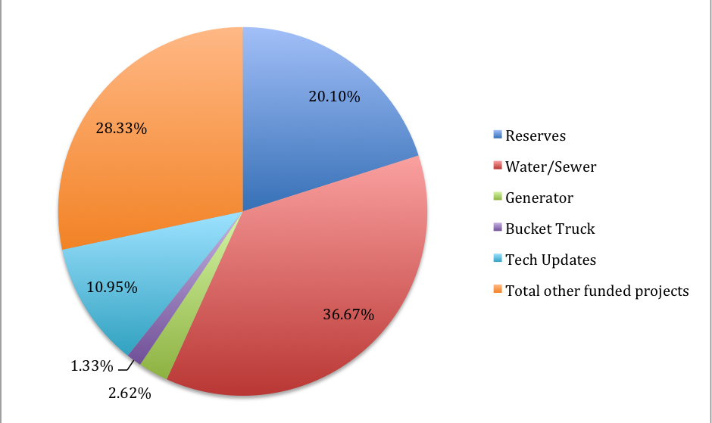
Top five funded capital projects as percentage of total group spending.

Slide 12
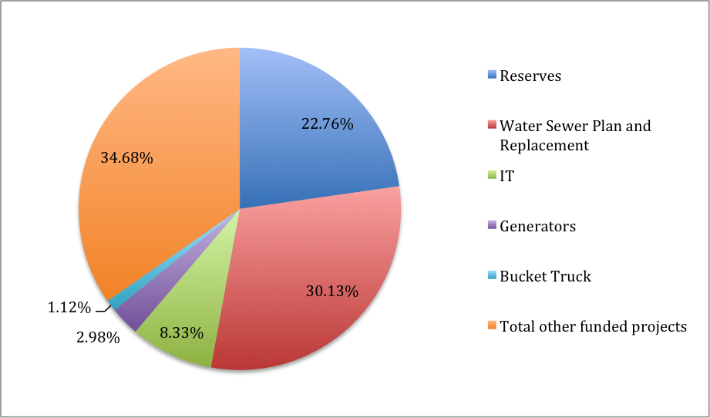
Top five projects as percentage of total allocation in both sessions

Slide 13
Top five projects
Water and sewer - 30.13%
Reserves – 22.76%
IT – 8.33%
Generators – 2.98%
Bucket Truck – 1.12%

Slide 14
T-SPLOST
Drainage and Paving Projects
Sidewalk Replacement
Traffic Signal Projects
Silent Crossings

Slide 15

Questions

